Slide 1


Capstone Project Phase 1
$$\text{Research} \text{on} \text{Path} \text{Planning} \text{Algorithm} \text{for} \text{Multi}\text{−}\text{UAV} \text{Targets} \text{Based} \text{on} \text{Genetic} \text{Algorithm}$$
Project number : 22-1-R-25
Supervisor:
Prof. Miri Weiss-Cohen
Students:
Ajwad Zidan
Mahmood Odeh

Slide 2
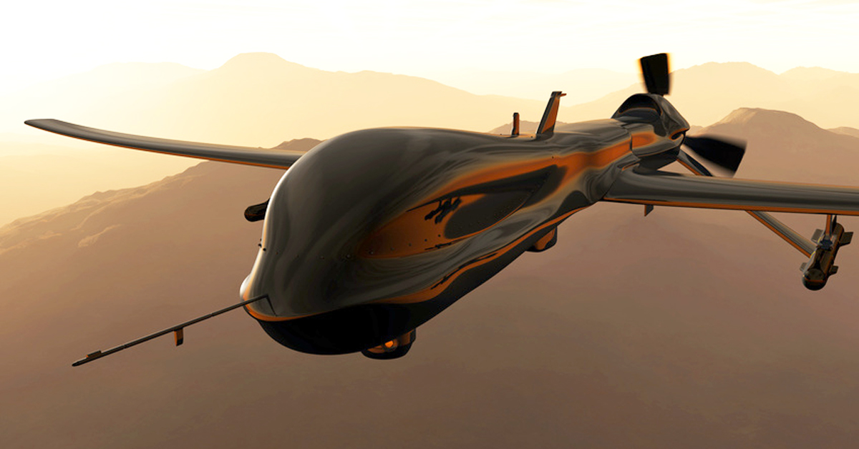
UAVs
UAV:
An unmanned aerial vehicle (UAV), is an aircraft without any human physical intervention
Uses:
Military, Research, Rescue
Types:
Size, Sensors, Power
Challenges:
Meeting the requirements of the tasks
Hiding from radars
Limitation:
Flight Hight, Speed, Life-Power

Slide 3
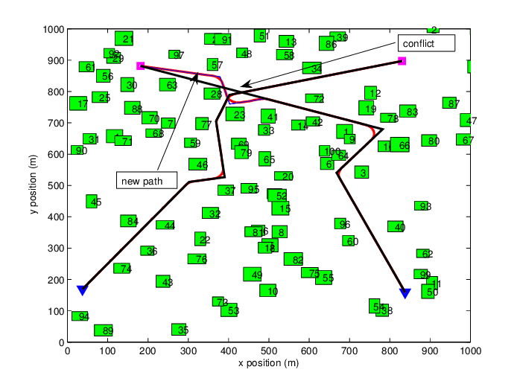

UAVs Path Planning
Purpose of the route:
Shortest, covering all targets, minimal costs
$Challanges$:
Safety
Physical feasibility
Performance of the mission
Real-time implementation
Online and Offline :
Obstacle and threat constraints
Environment:
2D and 3D
Algorithms for path planning:
GA , A* and DWA, Q learning

Slide 4
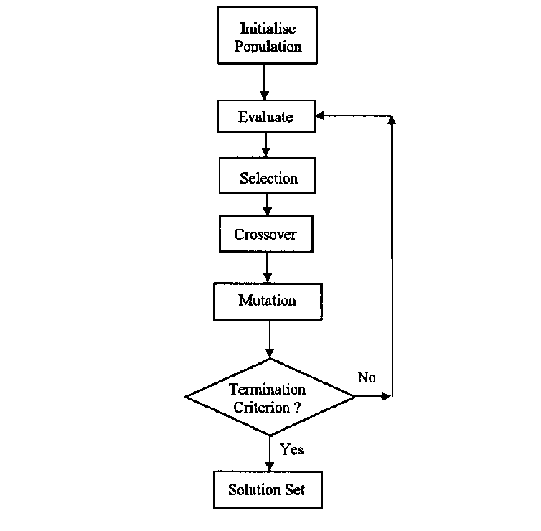
Genetic Algorithm
Definition:
Is a metaheuristic optimization algorithm that is inspired from the natural selection
Why GA:
Many variants of genetic algorithm have been developed and applied to a wide range of optimization problems
Operators:
Inspired from biological evolution process, for making new population

Slide 5
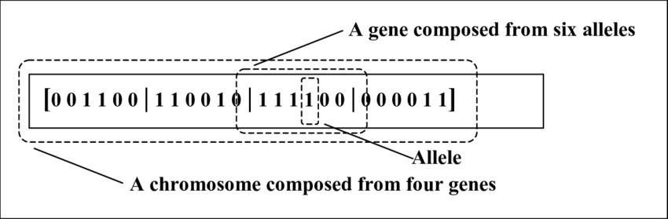
Genetic Algorithm – Encoding
The solutions (individuals) must be encoded in a particular bit string to be treated.
The encoding types are differentiated according to the problem domain.
Some of encoding types:
Binary-coded individuals
Octal-coded individuals
Value-coded individuals
Each allele or gene represents
characteristics of the solution.

Slide 6
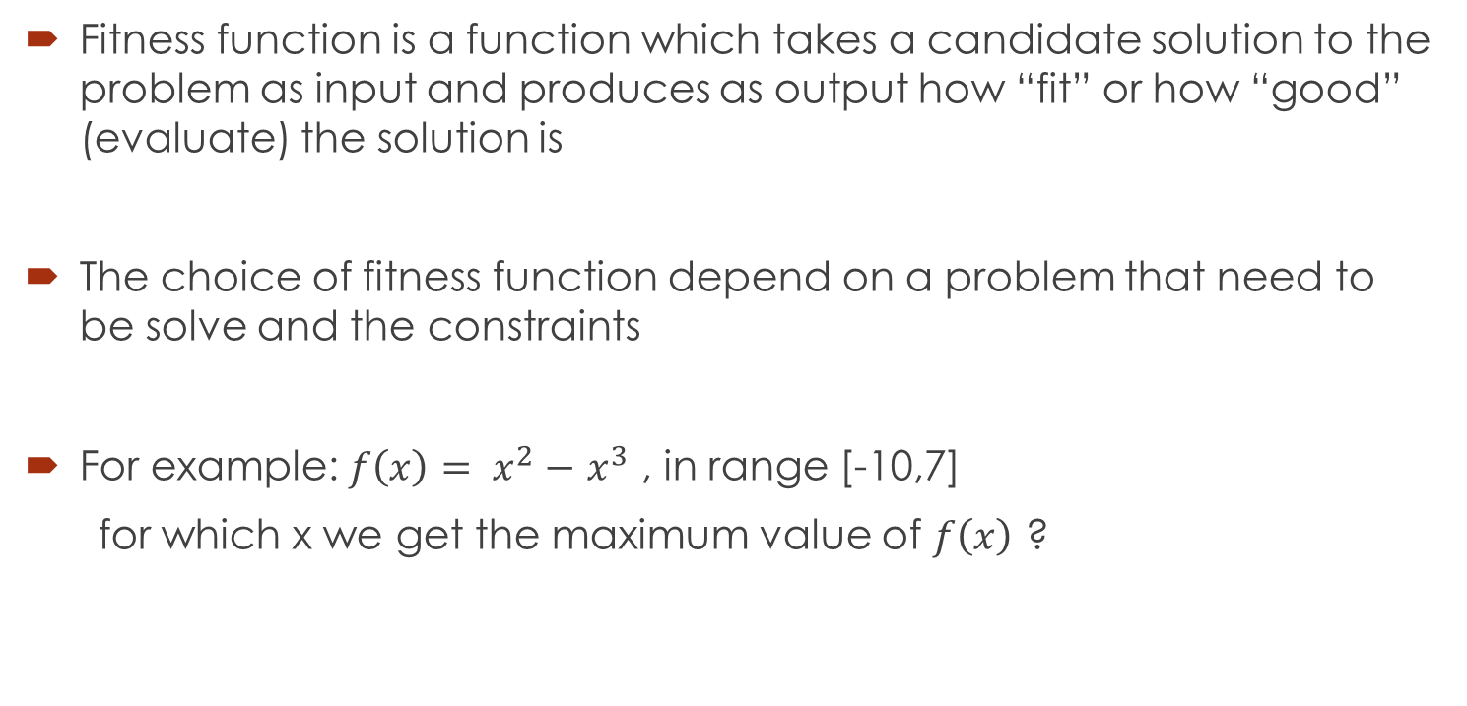
Genetic Algorithm – Evaluate Based On Fitness Function
Fitness function is a function which takes a candidate solution to the problem as input and produces as output how “fit” or how “good” (evaluate) the solution is
The choice of fitness function depend on a problem that need to be solve and the constraints
For example: $f\left(x\right)= x^{2}−$ $x^{3}$ , in range [-10,7]
for which x we get the maximum value of $f\left(x\right)$ ?

Slide 7
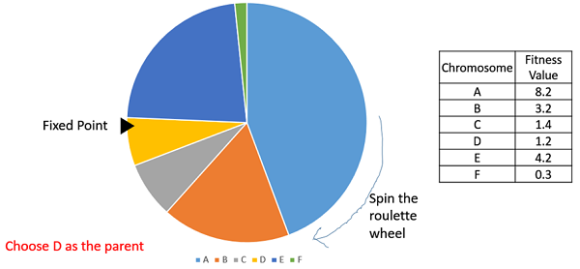
Genetic Algorithm – Selection
The first operator applied on a solutions
Selection determines whether the chromosome will participate in the next step of the algorithm or not
Well known selection techniques are :
Roulette wheel
Rank Roulette wheel
Boltzmann

Slide 8
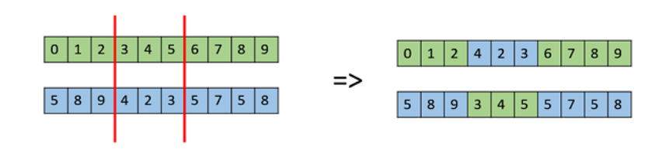
Genetic Algorithm – Crossover
Crossover operators used to generate new offspring
by combining the genetic information of two or more parents.
The two chromosomes participating in the crossover operation are known as parent chromosomes and the resulting chromosome are known as children chromosomes.
Well-known crossover operators :
Two-point crossover
K-points crossover
Order crossover

Slide 9
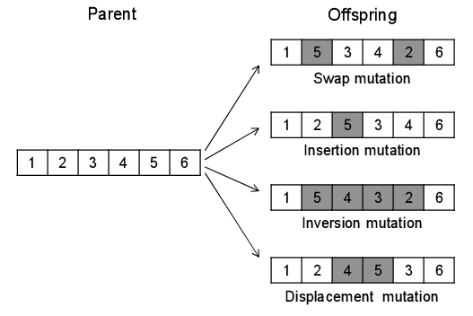
Genetic Algorithm – Mutation
Mutation operator adds new information in a random way to the chromosome .
Helps to avoid getting trapped at local optima.
Maintains the genetic diversity from one population to the next one.
Well-known mutation operators :
Displacement mutation
Uniform mutation
Inversion mutation

Slide 10
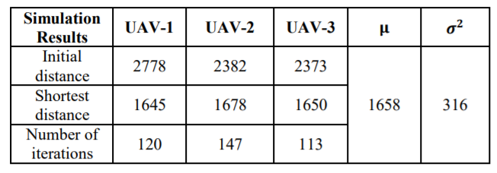
The problem to be solved
Path Planning for Multi-UAV Maritime Targets Search
The Goal: Get the optimal paths for each UAV by minimal costs
The solution we propose based on the research proposed by Lin, QUN and Li that based On GA and K-means algorithms for solving the problem, they achieved the following results, attesting to the efficiency of the genetic algorithm:

Slide 11
Our approach
Our approach: by changing and improving the GA operators, we try to :
reduce the search range of the algorithm
improve the running speed of the algorithm and global search ability compared with the solution proposed by Lin, QUN and Li

Slide 12
Our Solution 1
Code chromosome according to the centers of cluster + evaluate
Selection : the best and rank Roulette
First Algorithm: K-means Classification based on GA
Start points of targets and take-off of
each UAV are known
Purpose: cluster the set of targets into m clusters,
where m is equal to UAVs number
GA for learning and K-means for fitness :
Fitness function :criterion function of K-means
Chromosome:
[(𝑥1,𝑦1),(𝑥2,𝑦2), ..,(𝑥𝑚, 𝑦𝑚)]
Two-point crossover
Uniform mutation
Evaluate by fitness function
Reach iterations number ?
Yes
NO

Slide 13
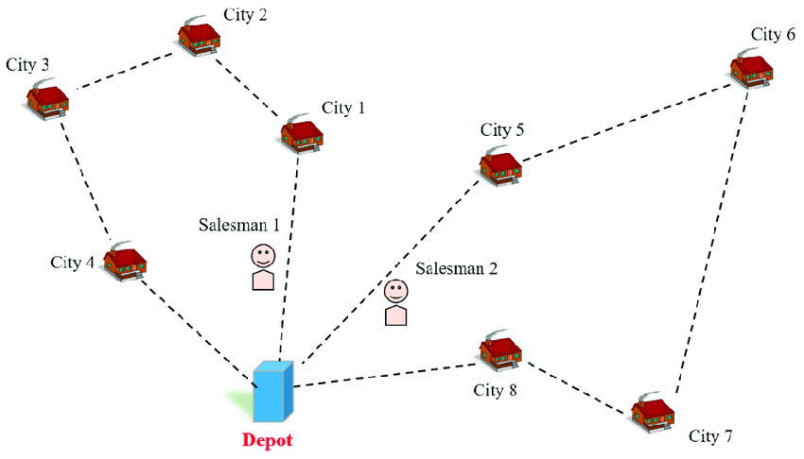
Our Solution 1
Similar to MTSP

Slide 14
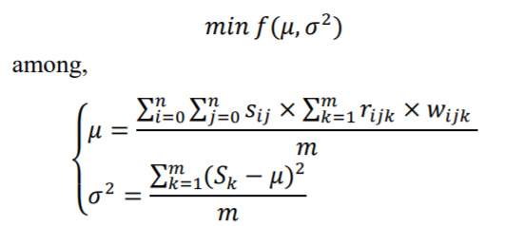
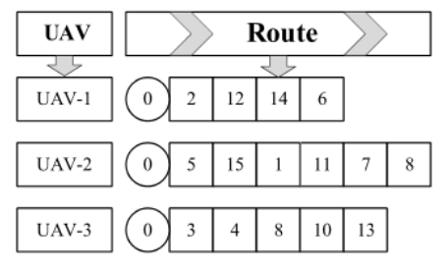
Our Solution 2
Multi chromosome coding, each gene as target + evaluate
Selection : rank Roulette
Second Algorithm : GA for path planning
Purpose :
Compute the UAVs Optimal paths
Special Operators:
Multi chromosome coding
Mean-variance as Fitness function
Two-point Swap crossover
Insertion and swap mutation
Evaluate by fitness function
9
Reach iterations number ?
Yes
NO

Slide 15
Expected achievements and Implementation
Expected achievements:
correct and accurate paths for UAVs that cover all the targets.
reduce the iterations number of the two sub algorithms we improving compared with the two sub algorithms proposed by Lin Li research, by changing and improving GA operators.
Implementation :
Java Coding
Testing
Validation by comparing

Slide 16
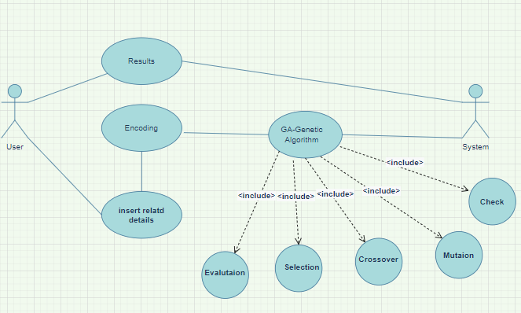
UML DIAGRAMS

Slide 17
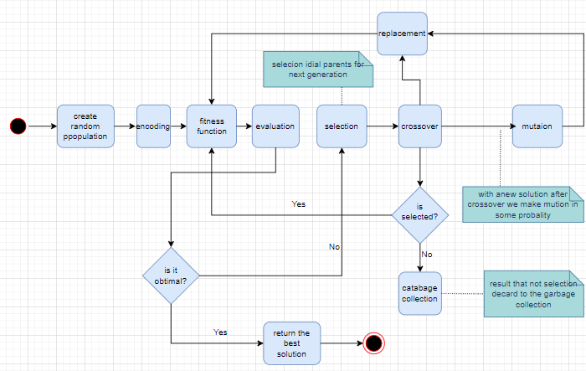
UML DIAGRAMS

Slide 18

Thank you

